Slide 1
Data-based Job Market in Hong Kong
An analysis of data-oriented job postings on Glassdoor on 19 June 2021.

Slide 2
Why are we doing this?

Slide 3

Our goals
Increasing transparency and clarifying data-based job market in Hong Kong.

Slide 4
Our offers
To offer a solution on how to optimise job search for prospective Data Analysts / Engineers / Data Scientists
To provide corporate HRs / recruiting firms with an efficient way of measuring competitive pays

Slide 5
Our Data

Slide 6
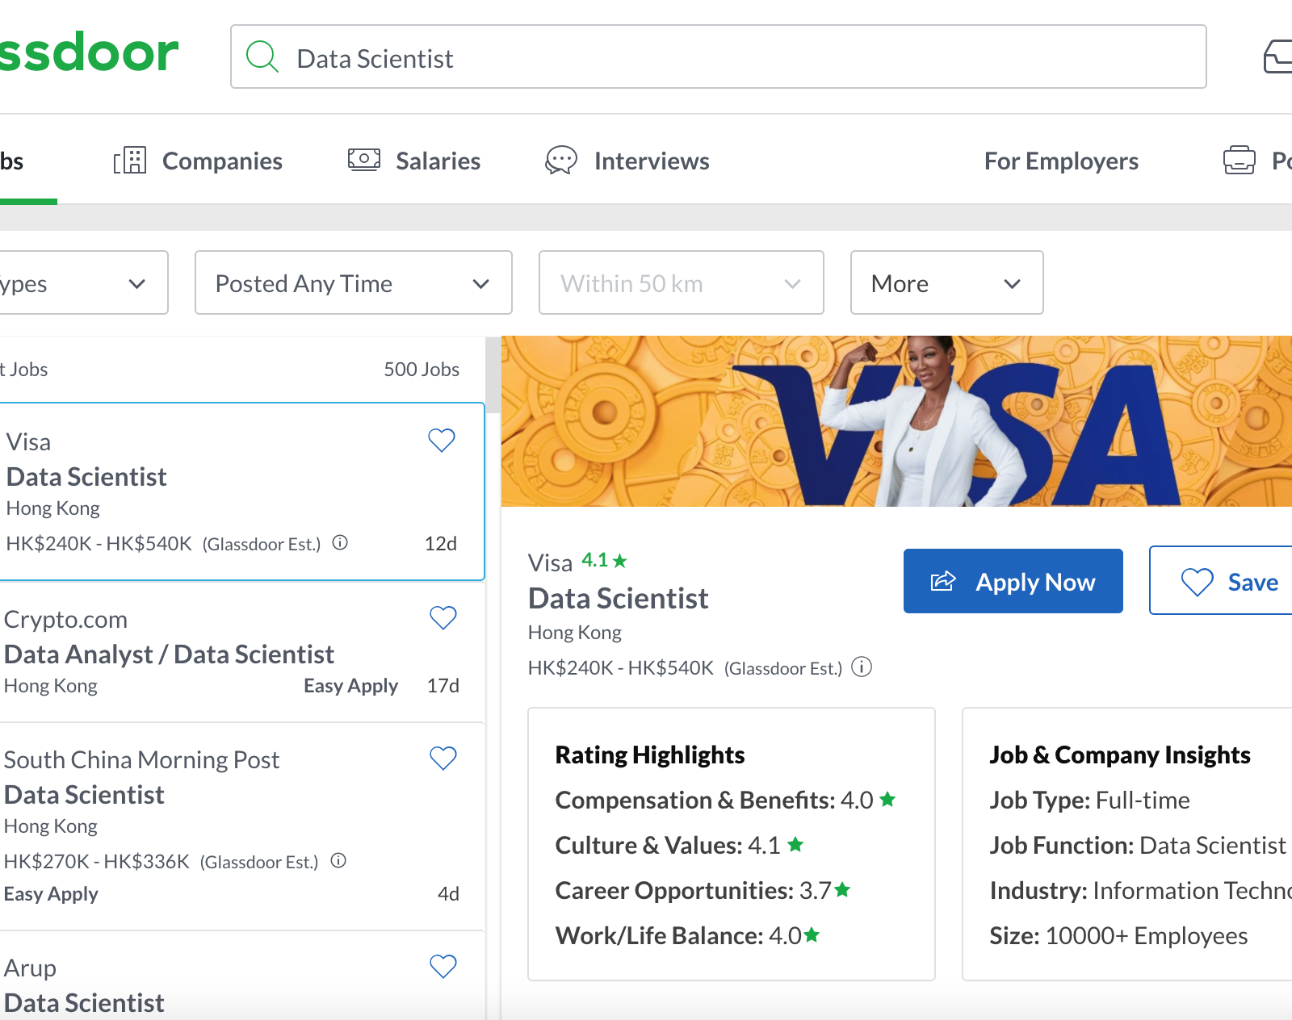
Glassdoor
Scraped multiple pages of job postings for the following roles:
Data Analyst
Data Engineer
Data Scientist

Slide 7
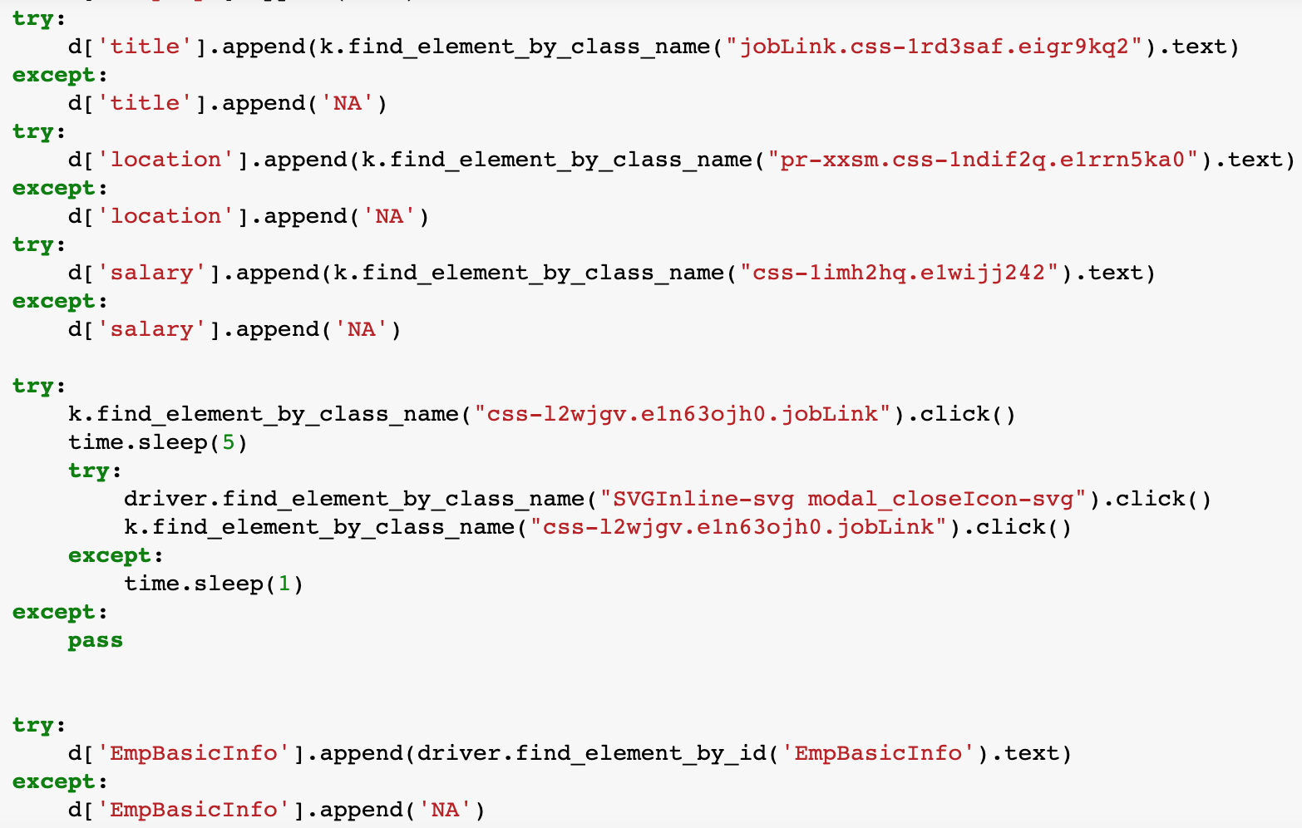
Our Method 1. Scraping
Scraped Glassdoor for each role using:
BeautifulSoup
Selenium
Data processing with:
Pandas, Time, Numpy, OS, Requests, Math

Slide 8
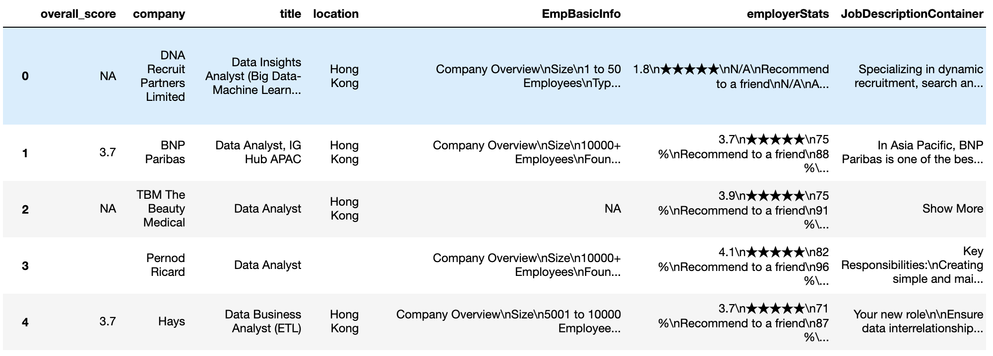
Our Method 2. Merging
Drop any duplicate rows
Drop any entries without company names to ensure high-quality data
Merge 3 data frames together

Slide 9
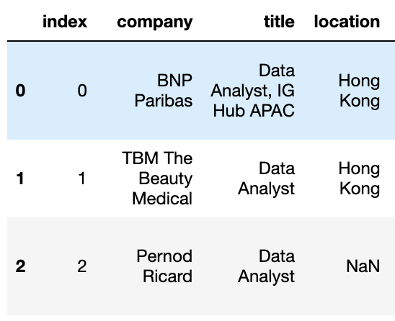
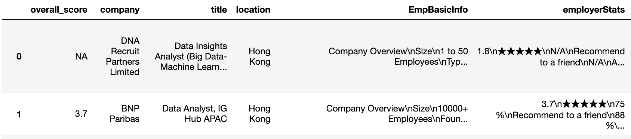
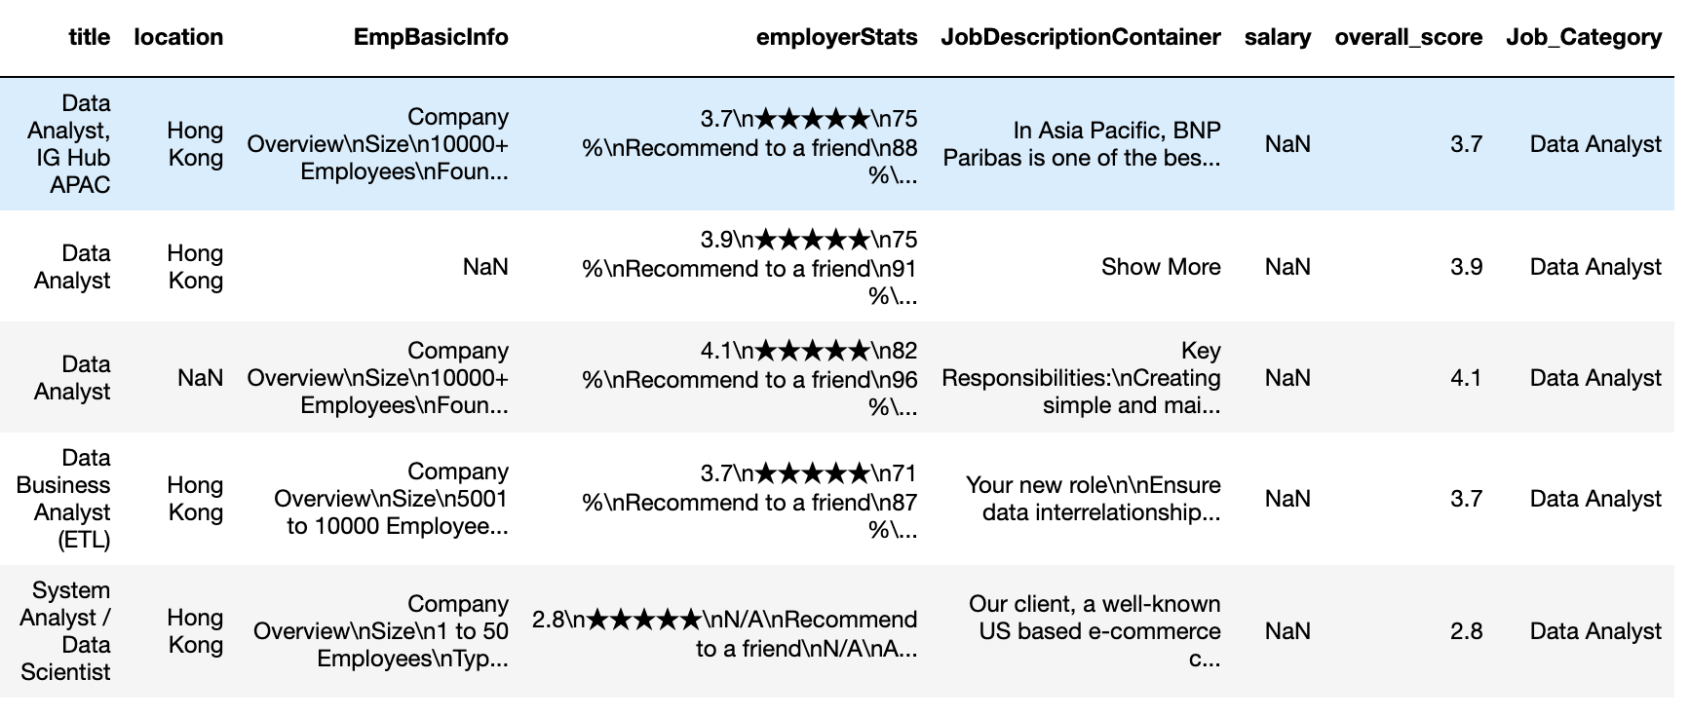
Our Method 3. Clean-up
Drop unnecessary columns
Ensure overall_score is extracted from the employerStats column
New column to categorise each role to Data Analyst, Data Engineer, and Data Scientist
Merge 3 data frames together
???
☺

Slide 10
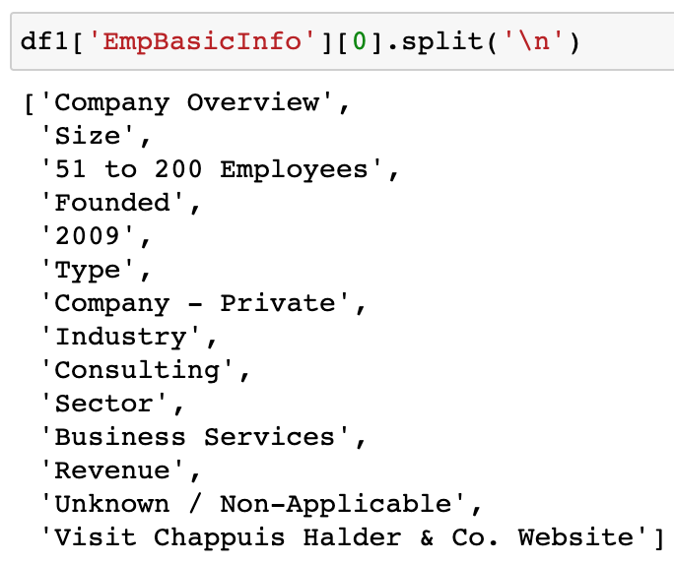
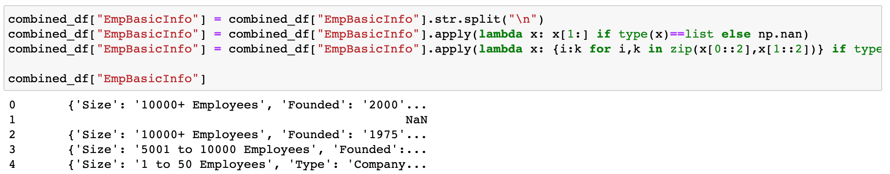
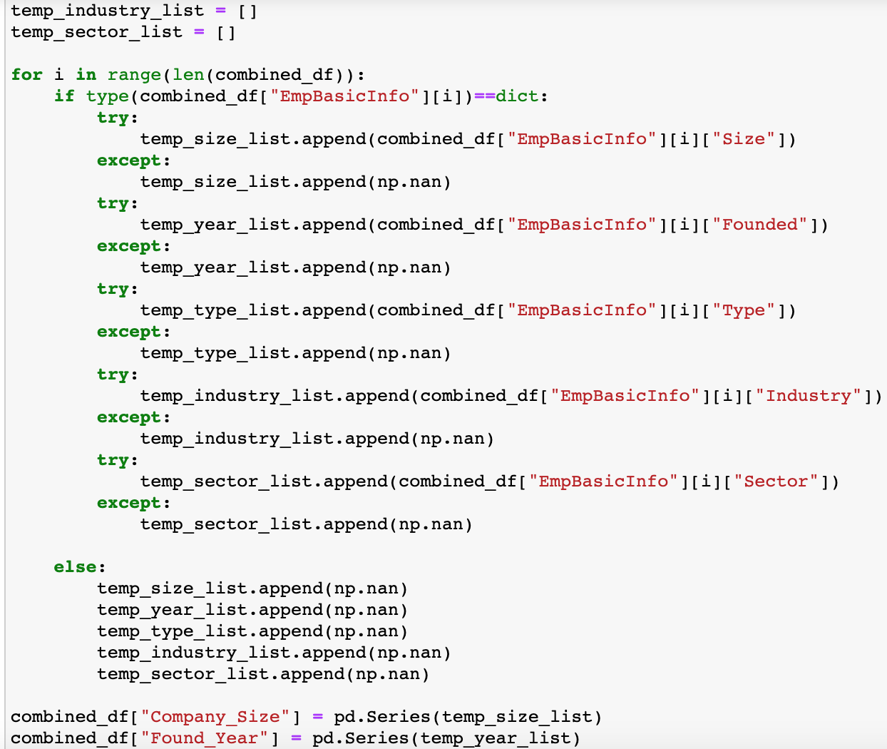
Our Method 3. Clean-up EmpBasicInfo
Split extracted strings
Create dictionary for each job posting
Build a temporal list for each intended independent variable
Append each list with extracted value from all created dictionaries

Slide 11
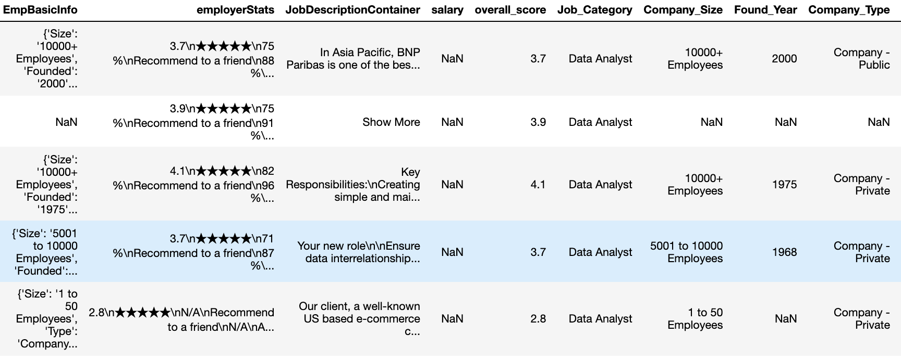

Slide 12
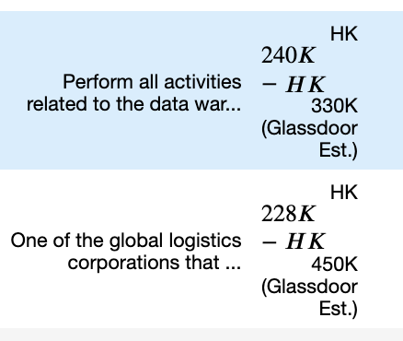

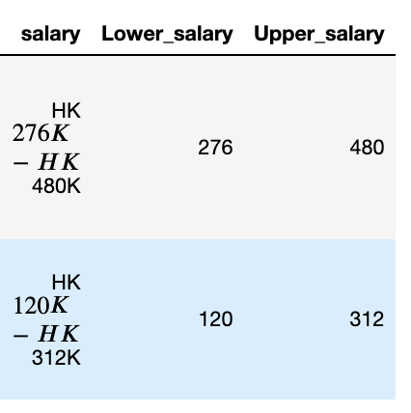
Our Method 3. Clean-up salary
Separate into Lower Range and Upper Range

Slide 13
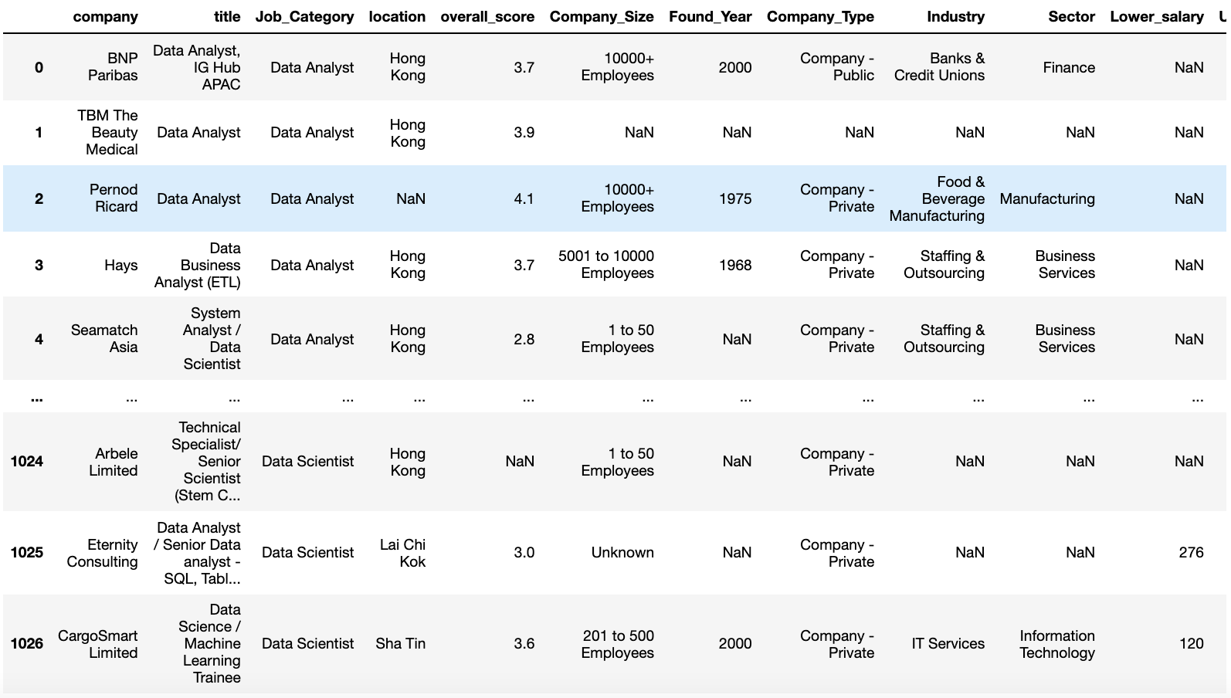
Our Method 4. Final Data Frame
Separate into Lower Range and Upper Range

Slide 14
Our Analysis

Slide 15
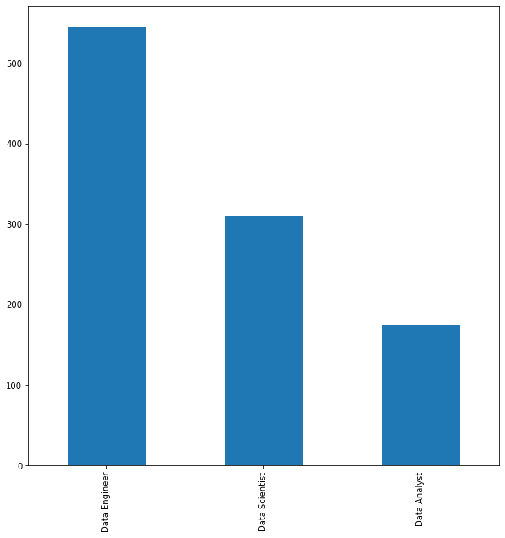
Overall Market
On 19 June 2021, job postings were dominated by Data Engineer by large margin:
544 Data Engineer
310 Data Scientist
175 Data Analyst

Slide 16
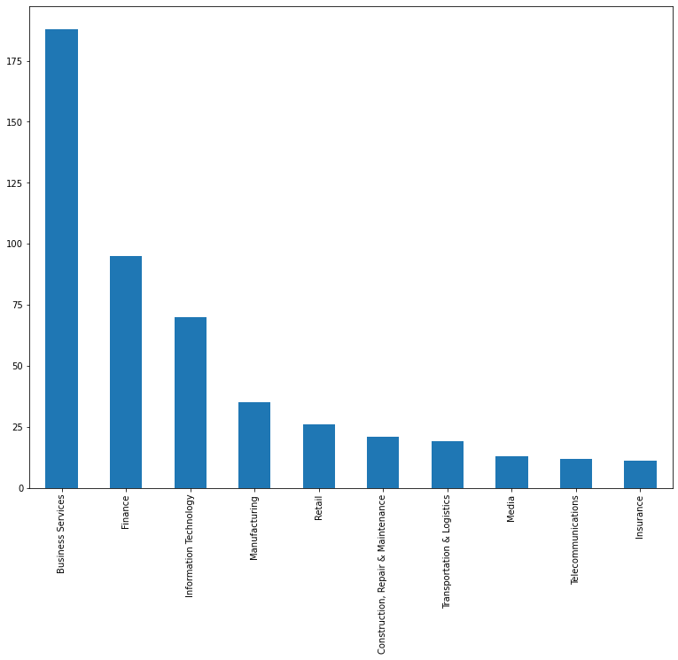
The Demand
Our analysis indicates that data-oriented jobs are most prominent in Business Services by a wide margin.
This is followed by Finance and Information Technology.

Slide 17
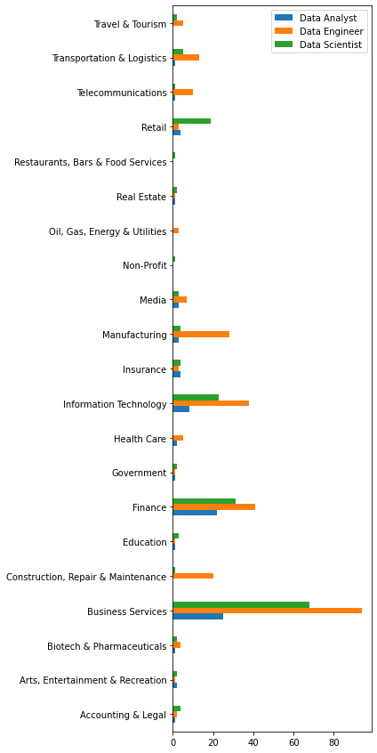
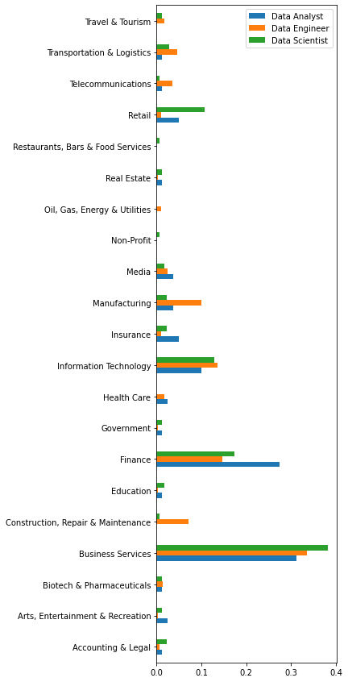
Sectoral Demand
Aaaaa
Aaaaa

Slide 18
Recruiters Galore
Job postings for Data Analyst are becoming more regularly managed by corporate…
… whereas those for Data Engineer and – especially – Data Scientists remain largely outsourced to recruitment firms.
NOTE: The values in the chart to the right refer to the ratio between:
Number of job postings in each respective Job_Category and Industry and the number of job postings; AND
Number of job postings in each respective Job_Category

